Slide 1

Instagram for Business
101

Slide 2


Presentation Download:
claninmarketing.com/workshops

Slide 3


Slide 4

Agenda
Your Goals & Audience
Instagram Users
Why Instagram?
Business Accounts
Profile Features
Creating Content Hashtags
Stories
Best Practices
Apps

Slide 5

Your Objectives
What do you want to achieve on Instagram?
What’s the purpose of your brand using Instagram?
What will Instagram allow you to do that other platforms don’t?
Who is your target audience and which members of your audience are active on Instagram?

Slide 6

Targeted Audience
Who do you want to talk to?
Where are they on the Internet?
What’s most important to them?
Audience Profiles
Demographic:
Income, gender, age, marital status, job status, ethnic background, and education levels
Psychographic:
Hobbies, behaviors, lifestyle choices, values, interests, and spending patterns.

Slide 7
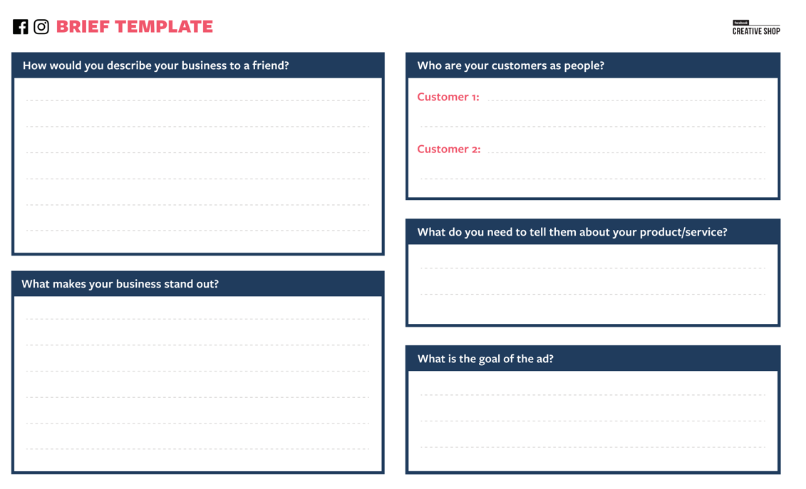

Slide 8

Instagram Users
64% of 18-29 year olds use Instagram
Millennials:
Born between 1981 and 1996
(Between 22-37 years old)
Gen Z:
Born between 1995 and 2015
(Between 4-24 years old)
Source: Pew Research Center & Sprout Social

Slide 9
Why Instagram?
People come to Instagram to be inspired and discover things they care about, and that includes content from brands and businesses.
25 Million+
business profiles worldwide
2 Million+
Advertisers worldwide use Instagram to share their stories and drive business results
60%
of people say they discover new products on Instagram
200 Million+
Instagrammers visit at least one Business Profile daily
80%
of accounts follow a business on Instagram
1/3
of the most viewed stories are from businesses
Source: Instagram

Slide 10
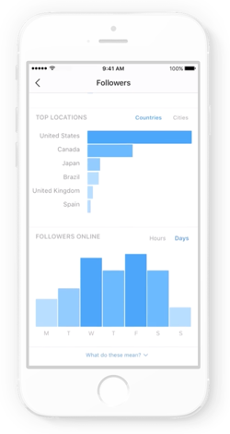
Be recognized as a business
Make your account on Instagram a Business Account to get insights about your stories, posts, and followers.
With a Business Account you can:
Get realtime metrics on how your stories and promoted posts perform throughout the day
Get insights into your followers and how they interact with your posts and stories
Add information about your company like business hours, location and phone number
Source: Instagram

Slide 11
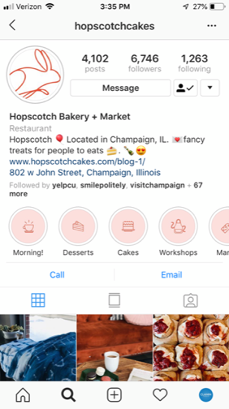
Profile Photo
Username
Name
Bio
Profile Features
Category
Highlights
Website & Address
Contact Options

Slide 12
Creating Instagram Content
Instagram is a highly visual experience. Learn how to tell your story through captivating photos, videos, and captions.
Getting Started on Instagram
1. Figure out what story you want to tell
2. Decide on a cohesive look and feel for your account
3. Post consistently
Stand Out with Good Creative
1. Include your logo, colors, or products to make content distinct
2. Tell a story that supports your business goal
3. Use well crafted creative
Source: Instagram

Slide 13
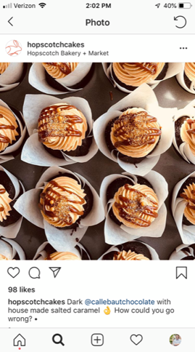
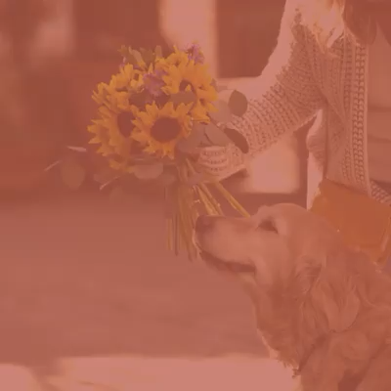
Creating Instagram Content
Create Quality Photos and Videos

Slide 14
4 tips to tailor your content
Look for trends across your posts and stories
Try to spot patterns across your photos and videos that are performing well, especially for metrics that are relevant to your business goals.
Keep your audience demographics in mind
Now that you know information like top cities and countries, age ranges and genders of your followers, keep that in mind as you plan your content. Your photos and videos should speak to the people that make up your community!
Post when your followers are active
Use Insights to see when most of your followers are on Instagram to learn when you can post your photos and videos. This way, you can maximize the number of people seeing and interacting with your photos and videos.
Turn your most engaging posts into ads
Popular post? Promote it and interpret how your ad performed with Insights so you can incorporate your findings into your next paid promotion!
Source: Instagram

Slide 15
Thumb-Stopping Content

Slide 16

What makes your thumb drop?
Save videos and graphics that make your thumb drop. Create a folder filled with inspiration!

Slide 17

Get creative and think
outside the box!
Video Example

Slide 18
Hashtags
Hashtags are a way to categorize your posts, reach a target audience, and help your target audience find you. Users are more likely to engage with your post because your post is exactly what they wanted.

Slide 19
Hashtag Tips
If you include the right Instagram hashtags on your posts, you will likely see higher engagement than you would if you didn’t have any.
Don’t use irrelevant hashtags
Use the right amount of hashtags
Use specific or niche hashtags
Consider using brand hashtags
Keep brand hashtags short and easy to remember

Slide 20
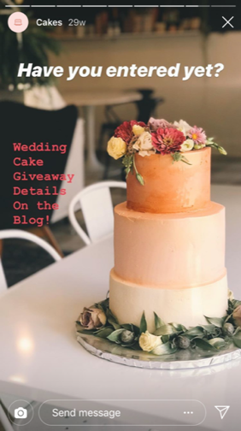
Stories
Instagram Stories allow Instagram users share photos and videos to their “Story” – which is visible to followers of the user’s Instagram account. Like Snapchat, Instagram Stories disappear after 24 hours.

Slide 21
People love stories from businesses
Over 400 million use Instagram Stories every day. Within this, over half of Instagram businesses create stories each month, and the community is watching – with one-third of the most viewed stories coming from businesses.
4 tips for sharing Instagram Stories:
Try something new: Tease new products, take viewers behind the scenes or play with creative tools like face filters, drawing tools and the polling sticker to get real-time feedback with your story
Get create: Share a combination of photos and videos to bring your story to life. Use features within stories, like Boomerang and Hyperlapse, to create engaging content.
Time is on your side: Since stories only last for 24 hours, take advantage of running flash sales, share sneak peeks or offer limited-time deals.
Think about sound: 60% of stories are viewed with sound on, so create content that sounds as good as it looks.
Source: Instagram

Slide 22

Instagram Reels
Reels invites you to create fun videos to share with your followers on Instagram. Record and edit 15-second multi-clip videos with audio, effects, and new creative tools.
Benefits to Reels:
Proven to boost and reach engagement
Allows businesses to get creative when promoting products or services
Reels are not resource-intensive and don’t require a big budget
Source: Instagram

Slide 23
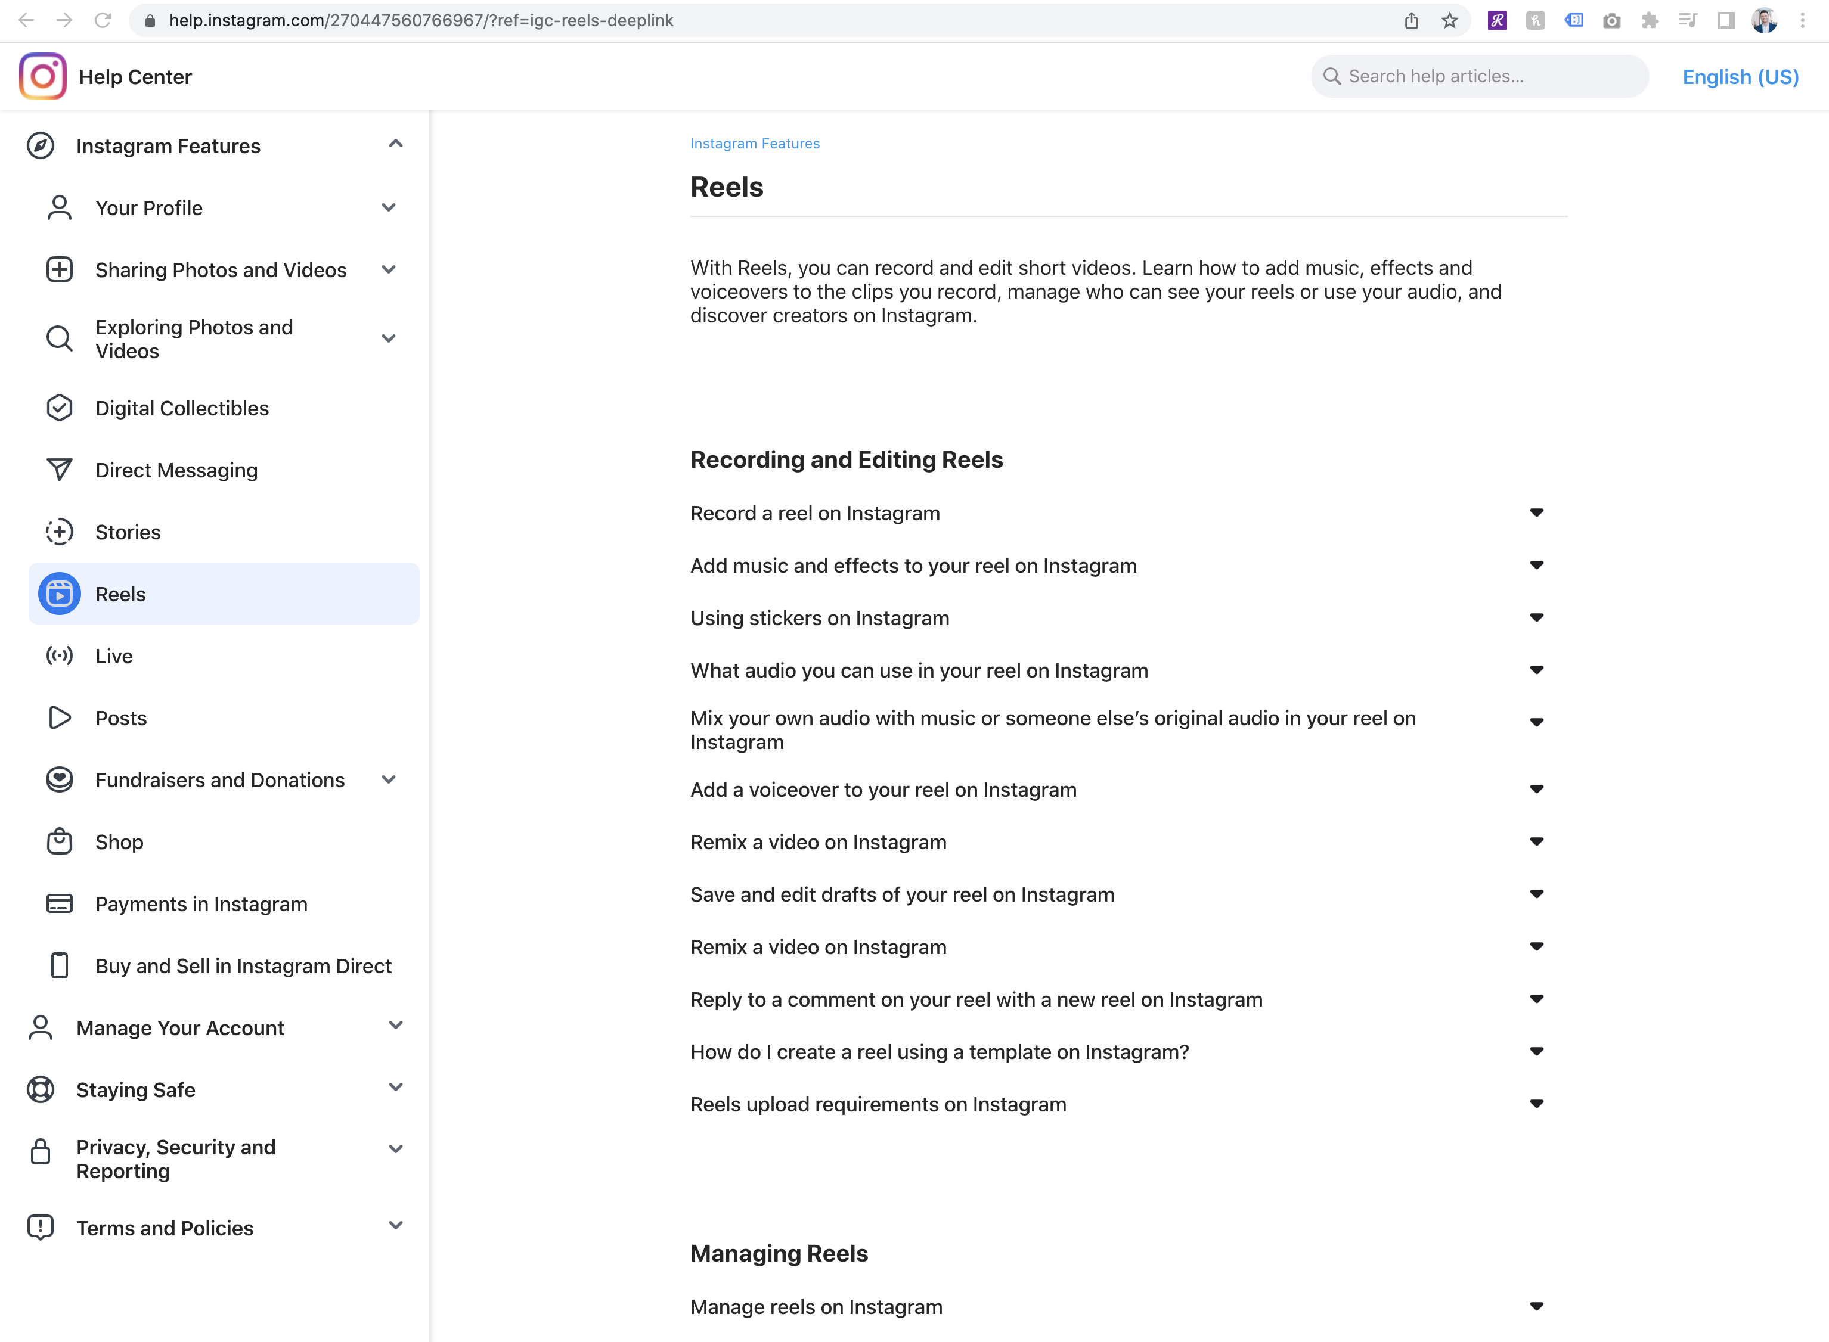

Slide 24
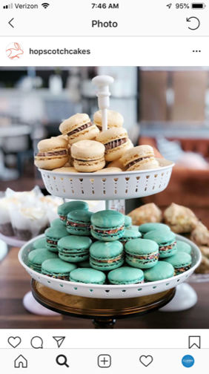
Other Best Practices
Maintain brand voice across your content
Stay relevant
Tag others when appropriate
Add location
Encourage user-generated content
Engage with your followers / include a call to action (CTA)
Post during optimal times (use Instagram Insights)
Get creative with emojis
Be current with Instagram trends and changes
Measure your efforts
Don’t be afraid to experiment

Slide 25
Recommended Apps
Layout
Mojo
Boomerang
Over
Hyperlapse
Unfold

Slide 26

Questions?
Scott Clanin
scott@claninmarketing.com
217-402-8077
claninmarketing.com

